Slide 1

ESQC 2026
Mathematical Methods Lecture 3
By Simen Kvaal

Slide 2
Today’s agenda:
Two «roadmaps»:
Mathematical topics
Quantum chemistry and relevant mathematics
Set theory
Calculus and vector calculus

Slide 3

A mathematical roadmap
How are mathematical topics connected?
Which topics are useful for quantum chemists?
We look at these 2 diagrams in the browser
Feedback welcome!

Slide 4
At the core: set theory
All of mathematics can be built using sets

Slide 5
Naïve set theory
In our lectures, like in most mathematics, we will use naïve set theory
Informal, intuitive formalism developed late 1800s
Contrast: axiomatic set theory
A matheatical theory with specific axioms
Everything derived from that
Standard foundation for all of mathematics:
ZFC = Zermelo-Fraenkel set theory with axiom of choice
Notes:
C = \{ \text{Romeo}, \text{Pallina}, \text{Micio}, \text{Luna} \} \subset \{ \text{italian cats} \} \subset \{ \text{all cats} \}

Slide 6
Basics of (naïve) set theory
A set is an unordered collection of objects:
The objects are elements:
Unrestricted comprehension generates new sets by assigning conditions on a set:
Notes:
C = \{ \text{Romeo}, \text{Pallina}, \text{Micio}, \text{Luna} \} \subset \{ \text{italian cats} \} \subset \{ \text{all cats} \}

Slide 7
Operations on sets
Union of two sets:
Intersection:
Set difference:

Slide 8
Subsets
A set can be contained in another set, i.e., be a subset:

Slide 9
Sets need not be simple ...
Infinite sets:
Sets containing sets:
Sets that are not explicitly known:

Slide 10
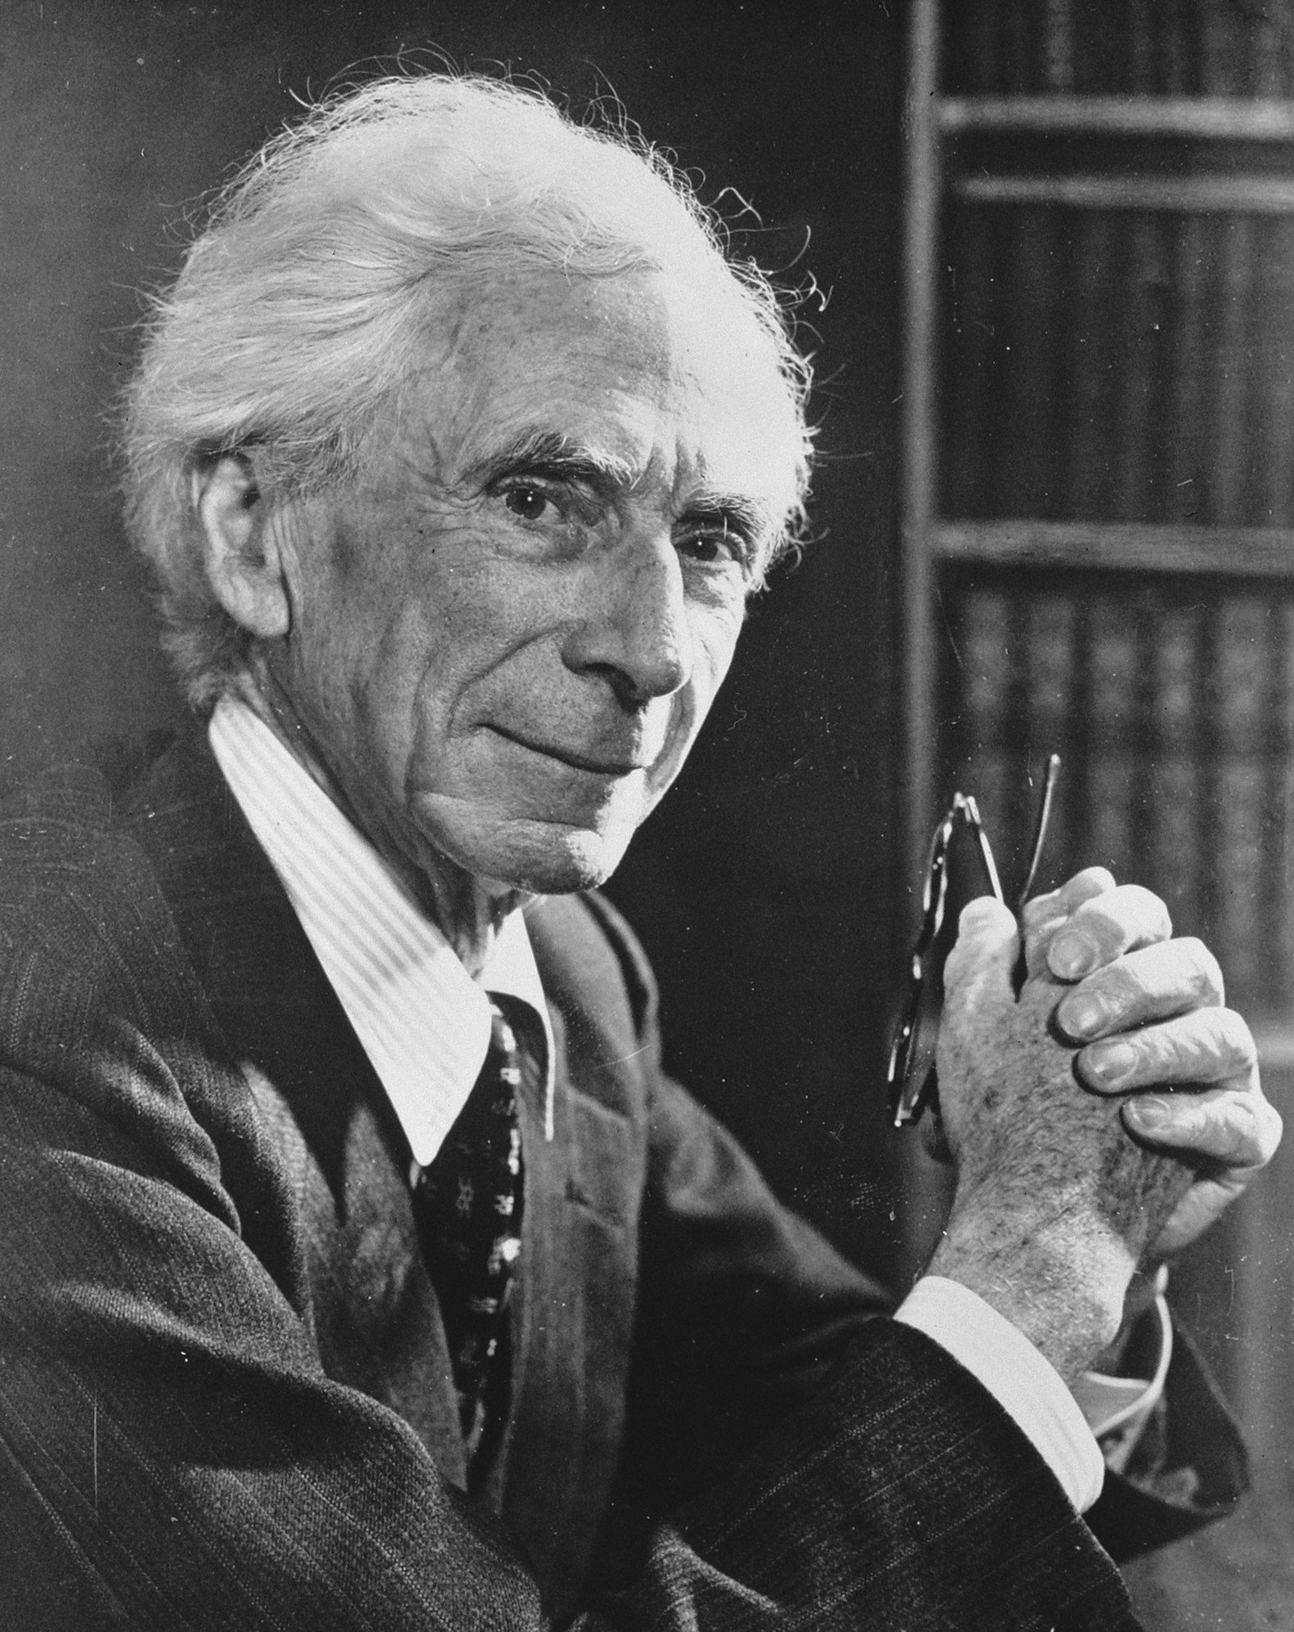
Russell’s paradox (1902)
In a town, there is a hairdresser who cuts the hair of everyone who does not cut their own hair.
Does the hairdresser cut their own hair?
Naive set theory has pitfalls
Bertrand Russell in 1957 (from Wikipedia)

Slide 11
Calculus
Functions, integration and differentiation, in one and several variables

Slide 12
Calculus: The local and the global
In calculus we try to understand functions of one variable:
Two fundamental operations:
differentiate = local change vs. integrate = global accumulation

Slide 13
Limits
Limits are important in calculus
f(x) approaches (the limit) L as x approaches a
The limit L may not exist.
Examples:
👍
👍
🤡

Slide 14
Continuity
A function is continuous at a if:

Slide 15
The derivative
The derivative is defined as a limit
The derivative is the slope of a line tangent to the graph
Demo: lecture-3-zoom.ipynb

Slide 16

Differentiability means local linearity
As we zoomed in:
The two became indistinguishable
A function is diffferentiable at x if it looks like a linear function when we zoom in

Slide 17
Standard identities one uses all the time
Linearity
Product rule
Chain rule

Slide 18
Taylor series
Repeated differentiation gives Taylor series expansion
When valid: Approximation of a complicated function by a simple polynomial
Demo: lecture-3-morse-taylor.ipynb
Slope
Curvature

Slide 19
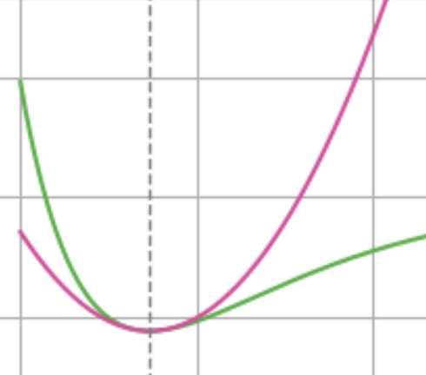
Critical points and optimization
Suppose we want to find a local maximum or minimum
At such points the slope is zero
Otherwise we would go up or down nearby!

Slide 20
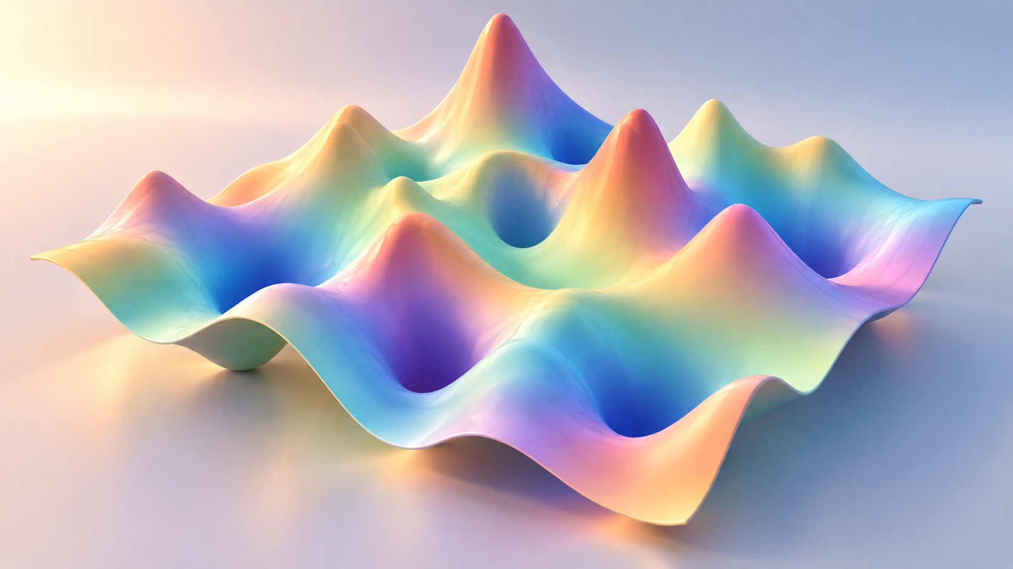
The n-dimensional generalizations are
directly relevant for geometry optimization and energy minimization in, say, HF or CI theory!

Slide 21
From local to global: Integration
The definite integral accumulates the function
«Area under graph»
Limit of (signed) area of small boxes
Demo: lecture-3-riemann.ipynb

Slide 22
Fundamental Theorem of Calculus
Integration and differentiation are inverse operations
Define
Then
The anti-derivative

Slide 23
End of lecture 3
Next up: Vector calculus
Calculus in many dimensions
Some things stay the same, other things change

